Slide 1

Welcome to Key Stage 1
2023-24

Slide 2

Link to website…

Slide 3
Homework
-Reading
-Topic
-Spelling

Slide 4

Reading

Slide 5

Year 1 and 2
Autumn 1: Topic
Autumn 2: Topic plus alternate Maths/ English homework

Slide 6
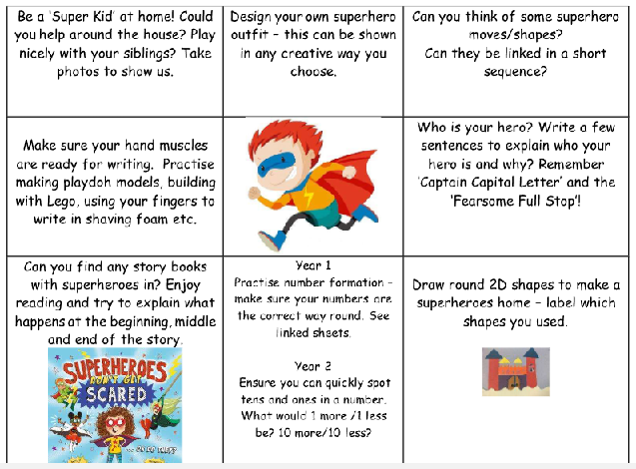

Slide 7

Year 2 only

Slide 8
lmarriott@st-bartholomews.leics.sch.uk
scrossley@st-bartholomews.leics.sch.uk
ccronin@st-bartholomew.leics.sch.uk
rcollins@st-bartholomews.leics.sch.uk
jbarrass@st-bartholomews.leics.sch.uk
smcgowan@st-bartholomews.leics.sch.uk
vwignall@st-bartholomews.leics.sch.uk

