Slide 1

Multiplication Tables Check (MTC) & beyond
Please ensure you have your volume on to hear the voiceover.
Updated May 2025

Slide 2
Overview
The importance of times tables
The progression of times tables through school
Key information about the Multiplication Tables Check
How you can help at home

Slide 3
Children will find it easier to solve more challenging maths problems and to do mental arithmetic if they have already memorised their times tables.
When children frequently, successfully recall their times tables they will grow in confidence and reduce their cognitive load.
Learning basic times tables will make it easier to learn more challenging ones (e.g., 3 and 6).
Why are times tables important?
Multiplication is used day to day throughout adulthood, whether it’s doubling recipes or splitting bills!
Multiplication underpins many other aspects of mathematics such as algebra, division and fractions – an early understanding of multiplication will help children right up to GCSE level and beyond.
Children will find maths exams less daunting as they will be assured in their ability to easily recall and apply their existing times tables knowledge whilst focusing on the question.
Recalling times tables improves memory skills, which is a transferrable skill that will help children throughout school and into adult life.

Slide 4
Year 1
Count in multiples of twos, fives and tens.
Make connections between arrays, number patterns and the counting of multiples.
Year 2
Count in steps of 2, 3, 5 and 10 from any number, forwards and backwards.
Recall and use multiplication and division facts for the 2, 5 and 10 tables, including recognising odd and even.
Year 3
Count from 0 in multiples of 2, 3, 4, 5, 8, 10, 50 and 100.
Recall and use multiplication & division facts for the 3, 4 and 8 multiplication tables.
Year 4
Solve problems involving materials, arrays, multiplication and division facts.
Write and calculate mathematical statements for multiplication and division using the multiplication tables they know.
Count in multiples of 6, 7, 9, 25 and 100.
Recall multiplication and division facts for the multiplication tables up to 12 x 12.
Use known and derived facts to mentally and formally multiple and divide, as well as applying this to solve problems.

Slide 5
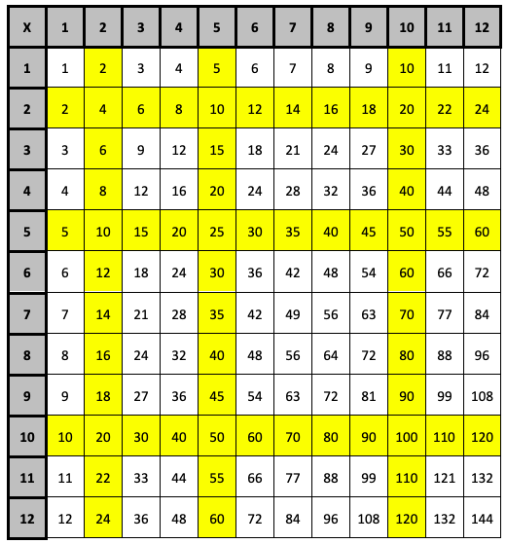
Year 2

Slide 6
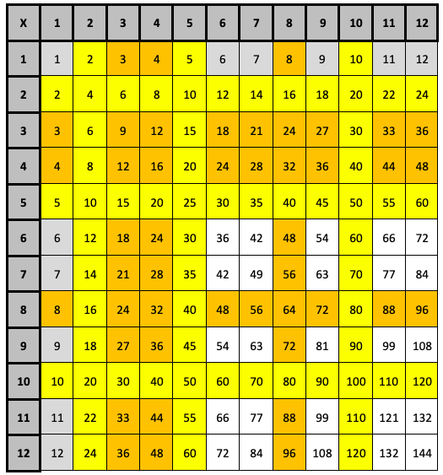
Year 3

Slide 7
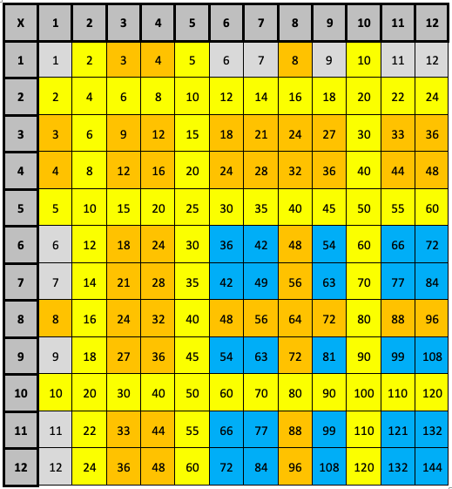
Year 4
14 new facts to learn
6 x 6 and 7 x 7
9 x 9 and 11 x 11
12 x 12
6 x 7 and 6 x 9
6 x 11 and 6 x 12
7 x 9 and 7 x 11
7 x 12
9 x 11 and 9 x 12

Slide 8
What is the Multiplication Tables Check?
The multiplication tables check (MTC) is statutory for primary schools.
The purpose of the MTC is to determine whether pupils can recall their times tables fluently, which is essential for future success in mathematics. It will help schools to identify pupils who have not yet mastered their times tables, so that additional support can be provided.
Schools must administer the MTC to all eligible Year 4 pupils within a two-week period commencing Monday 2nd June 2025.

Slide 9
How will the check be administered?
It is an on-screen check, which children can complete on an iPad or desktop computer.
The check consists of 25 times table questions.
Your child will be able to answer 3 practice questions before taking the actual check.
They will then have 6 seconds to answer each question.
On average, the check should take no longer than 5 minutes to complete.
The check will be administered in a mixture of large groups, small groups or individuals (dependent on the child’s needs).

Slide 10
Access arrangements
There are several access arrangements available for the check, these can be used to support pupils with specific needs.
The children will be trialling the check during May. Teachers will be using this as an opportunity to identify needs for different arrangements. Please inform your child’s class teacher if you think your child needs access to one (or more) of these arrangements.
Pupils are not allowed to have a pen or pencil, paper, calculator, mobile phone, smart watch or other items that may provide them with an advantage during the check.
Pupils cannot have additional time to complete the MTC questions. The purpose of the check is to determine whether pupils can recall their times tables fluently. Additional time would remove the fluent recall element of the check.

Slide 11
Access arrangements cont.
Colour contrast
(• yellow on black • black on blue • black on peach • blue on cream)
Font size
(increase or decrease text and number pad)
‘Next’ button
(instead of a 3 second pause between each question, the child must click ‘Next’)
Remove on-screen number pad
(only the question and answer box will be visible)
Input assistance
(staff member inputs the answer dictated by the pupil, criteria for this included)
Audio version
(the check will read all text aloud, including instructions, questions and inputted answers)
Audible time alert
(a beep two seconds before and a different beep for the end of time)

Slide 12
What happens after the check?
Pupils will not see their individual results when they complete the check.
Schools will see results (a total score for each pupil) from Monday 23 June.
School will inform you of your child’s score following this date (date and method TBC).
There is no expected standard threshold for the MTC.
The DfE will not publish school-level results for the MTC. There will be a statistical publication at national and local authority level and results will be available for schools to view.
We will provide the scores to the Year 5 teachers, so they can support further in the following academic year.

Slide 13
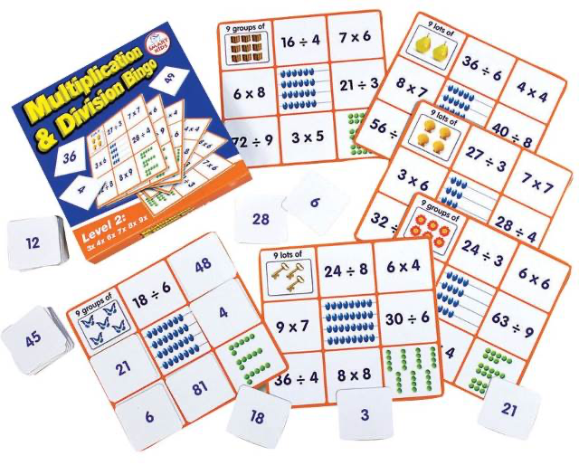
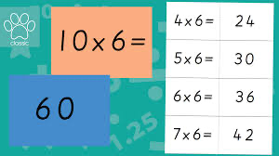
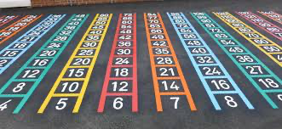
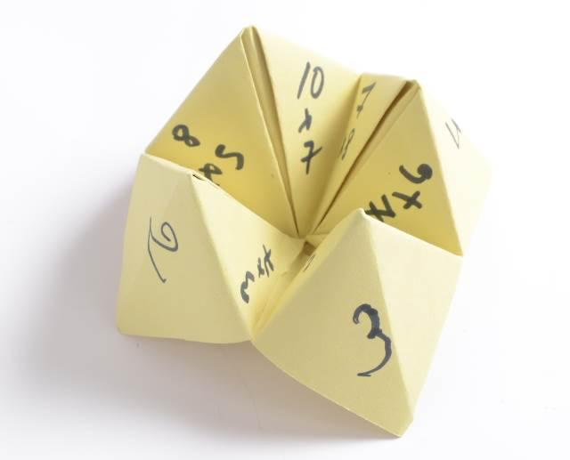
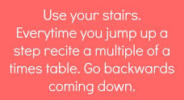
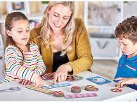
How to help at home
(offline)
Bingo
Times tables cards
(so many games!)
Drawing & writing outside
Learning alongside your child or competing against them
Fortune teller
(Chatterbox)
Visual or physical prompts

Slide 14


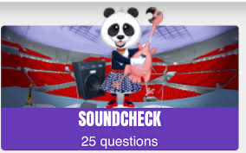




How to help at home
(online)
Many games to choose from on the TopMarks website
TT Rockstars
& the Soundcheck feature
SuperMovers:
Sports related active times table songs
Times tables games - Learn them all here!
YouTube:
Lots of different times tables songs
Hit the Button
(singular times table)
Just search for times tables games, videos or tips online!

Slide 15

Contact your child’s class teacher or
our Maths lead
twright@st-bartholomews.leics.sch.uk

